Slide 1

Process Mining Virtual Internship
by
R.LAKSHMI SREE
Roll No. 224G1A3341
Department of Computer Science and Engineering (AI &ML)
Srinivasa Ramanujan Institute of Technology
(Affiliated to JNTUA & Approved by AICTE) (Accredited by NAAC with ‘A’ Grade & Accredited by NBA (EEE, ECE & CSE)
Rotarypuram Village, B K Samudram Mandal, Ananthapuramu – 515701.
2024 - 2025

Slide 2



Contents
Process Mining Virtual Internship
Course Objective
Introduction
Technology
Applications
Modules
Real Time applications
Learning outcomes
GitHub Link
Queries
224G1A3341

Slide 3
Course Objective
Process Mining Virtual Internship
It offers objective , fact based insights, derived from actual data, to help you audit, analyze, and improve your existing business processes.
It is faster, cheaper and accurate than the lengthy and often subjective process mapping workshops.
Process mining works on top of your existing systems, helping you to leverage your existing technology investments. There is no rip-and-replace involved.
Real-World Applications
System Transformation
Sustainability
Finance
224G1A3341

Slide 4
Introduction
Process Mining Virtual Internship
What is process Mining?
Process mining is a set of techniques for the analysis of operational processes based on event logs extracted from company’s databases, information systems, or business management software such as enterprise resource planning (ERP), customer relationship management (CRM), electronic health records (EHR), etc.
In simple words, it’s about finding out how processes are actually performed to discover problems and areas for improvement.
Process mining сan also be described as a part of business process management (BPM) that applies data science (with its data mining and machine learning techniques) to dig into the records of the company’s software, get the understanding of its processes performance, and support optimization activities.
224G1A3341

Slide 5
Technology
Process Mining Virtual Internship
Process mining applies data science to discover, validate and improve work flows. By combining data mining and process analytics, organizations can mine log data from their information systems to understand the performance of their processes, revealing bottlenecks and other areas of improvement
Process mining involves the following key steps:
1. Data Extraction
2. Data Pre-processing
3. Process Discovery
4. Conformance Checking
5. Analysis
224G1A3341

Slide 6
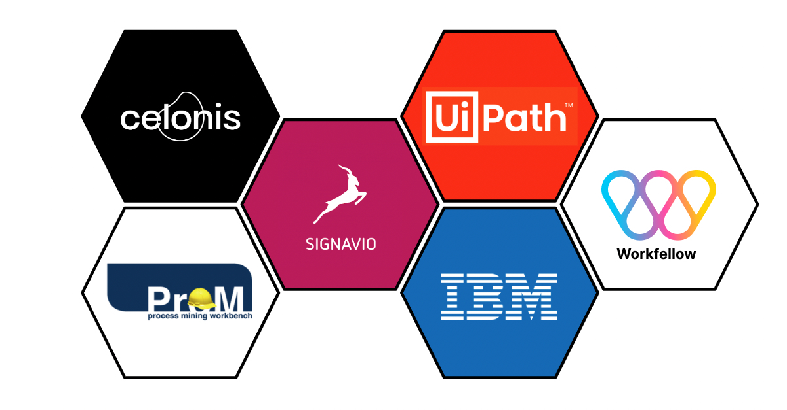
Different Types Of Technologies:
Process Mining Virtual Internship
Process Discovery Tools:
Disco: A popular process mining tool that offers process discovery, conformance checking, and performance analysis capabilities
Celonis : Offers a process mining platform with advanced AI capabilities for discovering, monitoring, and improving processes
224G1A3341

Slide 7
Different Types Of Technologies:
Process Mining Virtual Internship
Data mining: Data mining is the process of sorting through large data sets to identify patterns and relationships that can help solve business problems through data analysis.
Machine learning: Machine learning is a branch of artificial intelligence (AI) and computer science which focuses on the use of data and algorithms to imitate the way that humans learn, gradually improving its accuracy.
Process modeling: Process Modeling is another way of visually representing the process and operations of a business. It can help managers make decisions about how to optimize their resources and improve efficiency in their process through the development of a process model.
224G1A3341

Slide 8
Modules
Process Mining Virtual Internship
How does process mining works.
Main components of process mining.
Process Visualisation and Analytics.
How to start a project in process mining.
Why Companies need Process Mining.
Benefits of process mining.
Examples of process mining.
224G1A3341

Slide 9
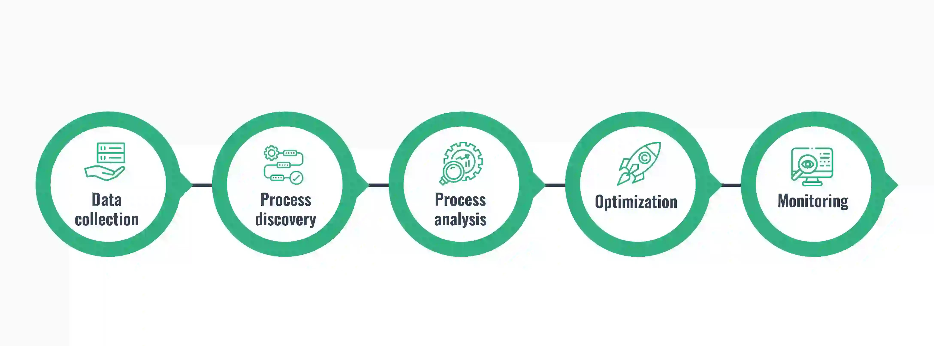
How Does Process Mining Works?
Process Mining Virtual Internship
behind everything your organization does: buying, selling, paying, collecting, shipping, and so on. When
224G1A3341

Slide 10
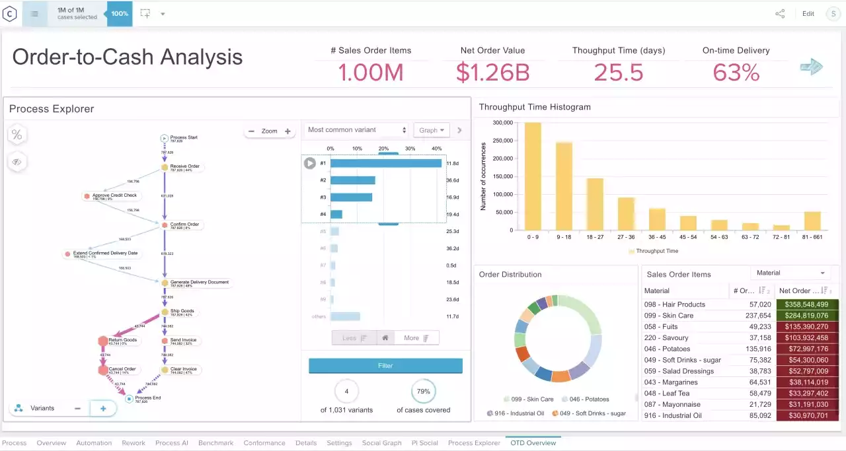
Process Visualisation and Analytics
Process Mining Virtual Internship
224G1A3341

Slide 11
How to Start a Project in Process Mining
Process Mining Virtual Internship
To start a project in the stream of process mining one need to follow some basic requirements they are classified as follows.
Determine Problem: Identify the problem of importance to the business that can realistically be addressed with process mining.
Identify the Data: Identify the data sources that need to be fully understood to address the business process issues under consideration.
Accept Truth: Accepting the results of the analysis, as process mining provides, among other things, a clear picture based on facts.
224G1A3341

Slide 12
How to Start a Project in Process Mining
Process Mining Virtual Internship
To start a project in the stream of process mining one need to follow some basic requirements they are classified as follows.
Determine Problem: Identify the problem of importance to the business that can realistically be addressed with process mining.
Identify the Data: Identify the data sources that need to be fully understood to address the business process issues under consideration.
Accept Truth: Accepting the results of the analysis, as process mining provides, among other things, a clear picture based on facts.
224G1A3341

Slide 13
Why Companies need Process Mining?
Process Mining Virtual Internship
Make Data-Driven Decisions
2.Gain a Comprehensive Understanding of Your Processes As-Is:
To make a wise technology investment, you need to have a clear vision of your goals and a solid grasp of your current state. Process mining can help you understand the ins and outs of your current processes .
3. Improve Process Performance Management
Process mining tools can automate the data collection of process and employee performance management, ensuring that these jobs get done without bias or human error.
224G1A3341

Slide 14
Benefits of Process Mining?
Process Mining Virtual Internship
Reduced costs: Process mining can help organizations to identify and eliminate waste in their processes. This can lead to significant cost savings.
Improved customer satisfaction: Process mining can help organizations to improve the customer experience by identifying and addressing issues in their processes.
Real-time monitoring: Process mining can be used to monitor processes in real time, which can help organizations to identify and address issues as they occur.
Enhanced decision-making: Process mining can help organizations to make better decisions about their processes by providing insights into the actual process flow.
Reduced risk: Process mining can help organizations to reduce the risk of errors and fraud by identifying and addressing deviations from the standard process.
224G1A3341

Slide 15
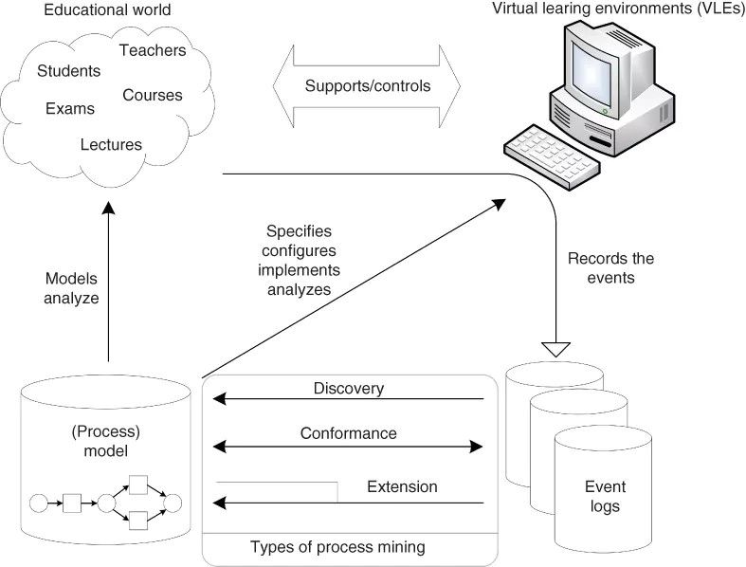
Examples of Process Mininng
Process Mining Virtual Internship
Education:
Educational process mining (EPM) is the practice of leveraging tools to discover insights in educational data which comes from various sources and is stored in different formats. Today, with the increasing use of information communication technology (ICT) in education, online learning solutions have gained popularity, generating large data volumes.
Business pr
224G1A3341

Slide 16

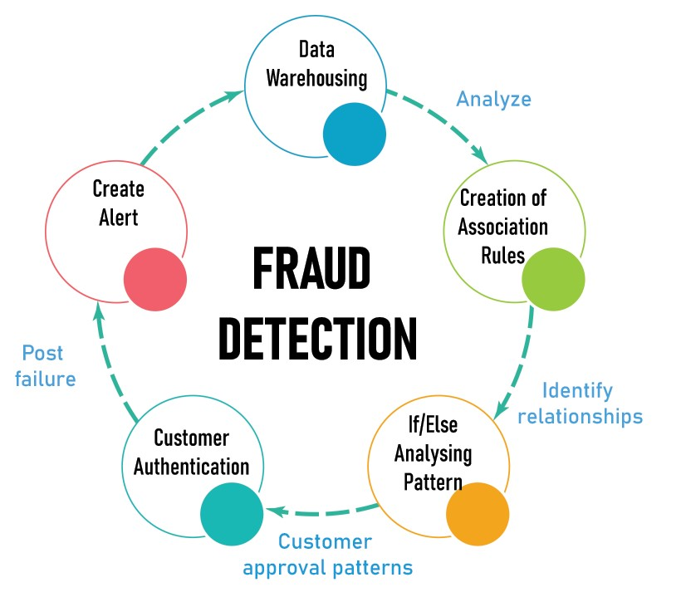
Real Time Applications
Process Mining Virtual Internship
Fraud Detection and Prevention: Process mining can uncover unusual patterns and deviations in financial transactions or operational processes, which could be indicative of fraudulent activities. By analyzing event logs, organizations can detect and prevent fraudulent behaviors in real-time.
224G1A3341

Slide 17
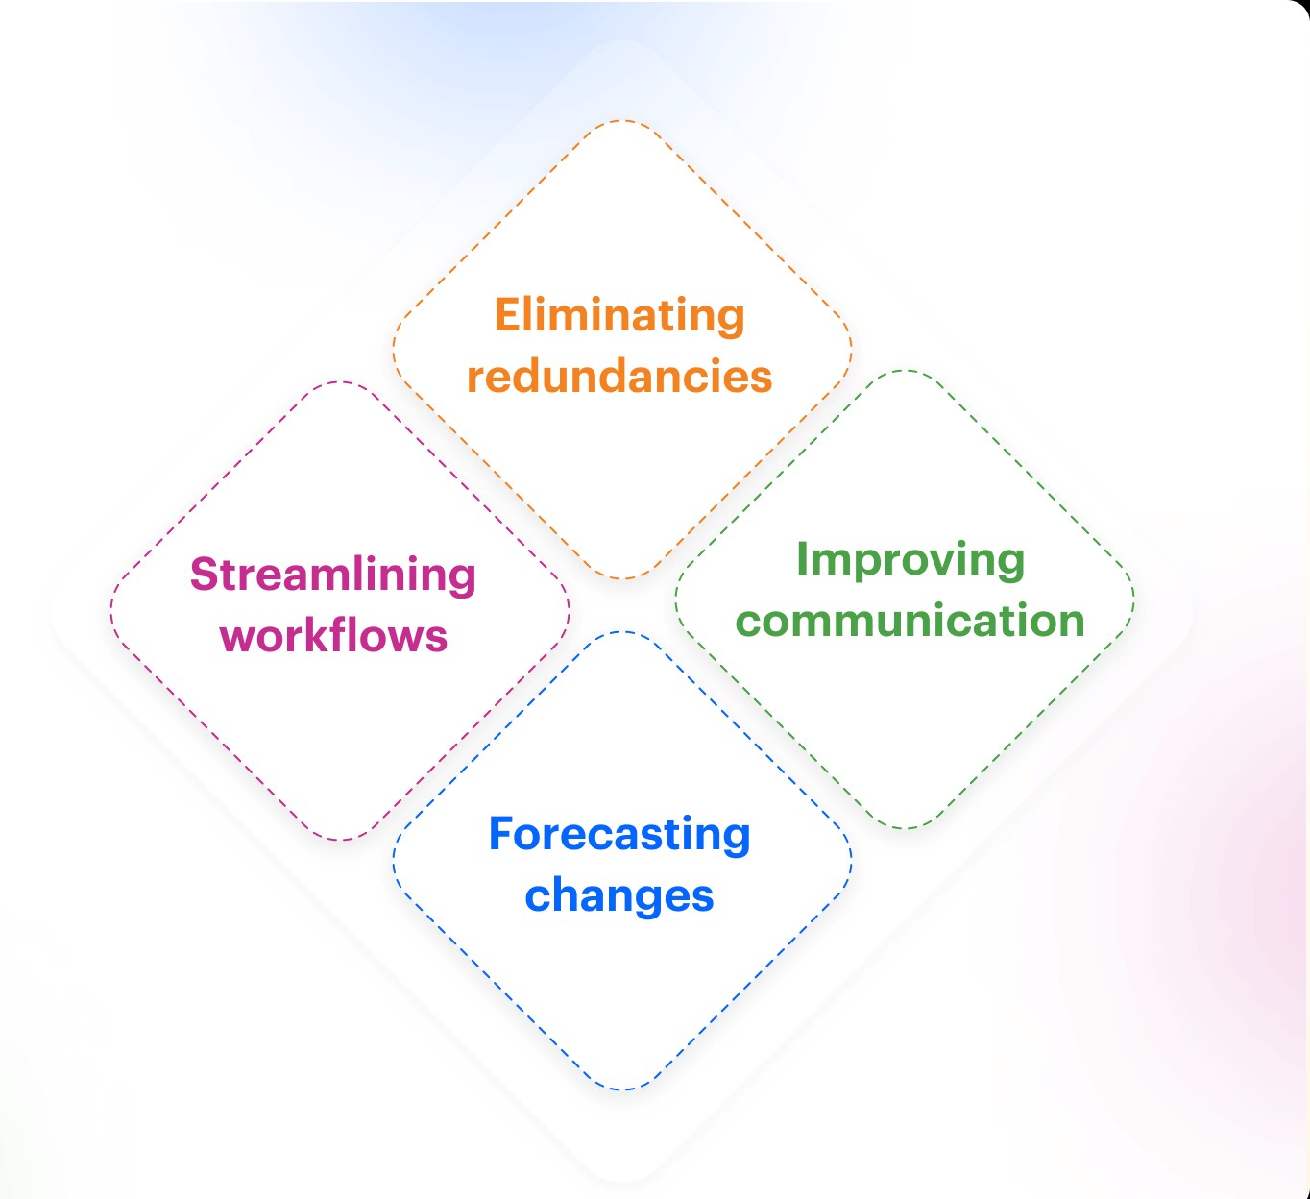
Real Time Applications
Process Mining Virtual Internship
Business Process Optimization: Process mining helps organizations identify inefficiencies, bottlenecks, and deviations in their processes. By visualizing process flows and analyzing event data, companies can optimize their processes for better resource utilization, reduced costs, and improved efficiency.
Business processes are the lifeblood of your company. There’s a process behind everything your organization does: buying, selling, paying, collecting, shipping, and so on. When
224G1A3341

Slide 18
Learning Outcomes
Process Mining Virtual Internship
Process Mining aims to discover, monitor, and improve processes based on the actual data rather than relying solely on models or assumptions.
process mining can be a powerful tool for improving the efficiency and effectiveness of business processes, and is increasingly used by organizations to drive process improvement efforts.
Gain a comprehensive view of end-to-end process flows through visual representations
Identify what kinds of technologies are used for different application.
Business processes are the lifeblood of your company. There’s a process behind everything your organization does: buying, selling, paying, collecting, shipping, and so on. When
224G1A3341

Slide 19
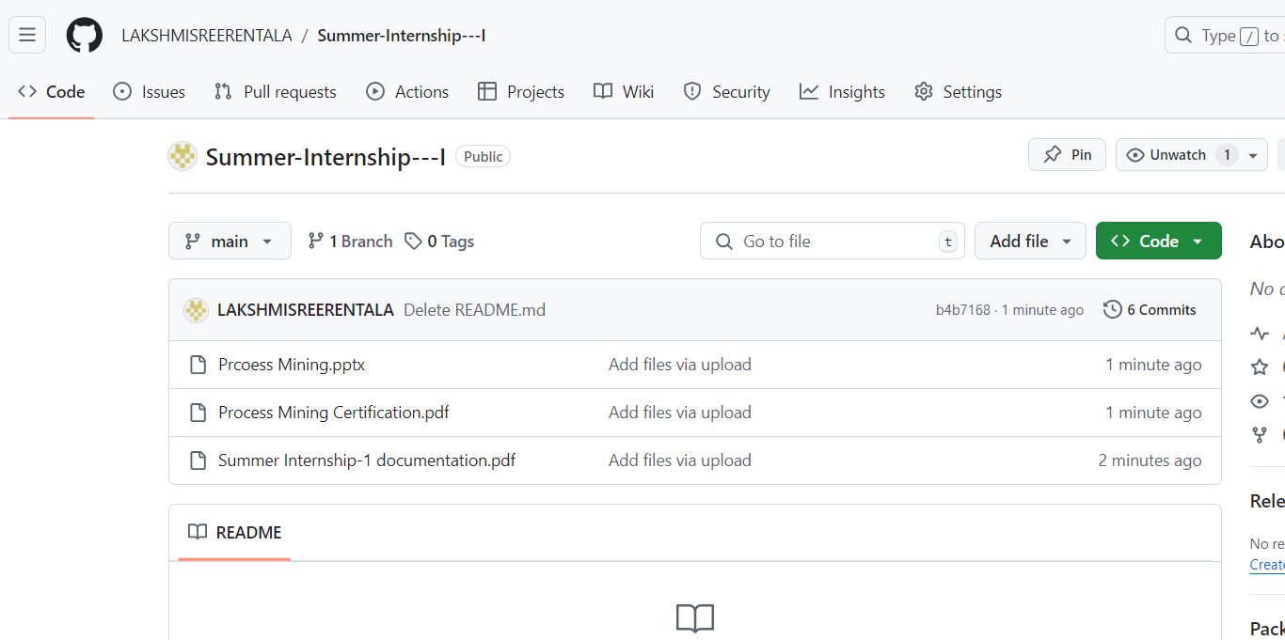
Git Hub Dashboard
Process Mining Virtual Internship
Repository Name : Summer Internship - I
Git Hub Link:https://github.com/LAKSHMISREERENTALA
224G1A3341

Slide 20
Process Mining Virtual Internship
Any Queries?
224G1A3341

Slide 21
Process Mining Virtual Internship
Thank You!!!
224G1A3341

